Slide 1
Prevention of NFC Relay Attack using Time-Based Two-Factor Authentication
Swanand Sawant Sriman Yadagiri

Slide 3
FLOW
NFC Introduction.
Relay Attack.
Working of Contactless Payments (NFC Credit Cards).
Time-Based Two-factor Authentication.

Slide 4
What is NFC?
NFC is a standard-based wireless communication technology that allows data to be exchanged between devices that are a few centimeters apart.
NFC operates at 13.56 MHz and transfers data at up to 424 Kbits/seconds.

Slide 5
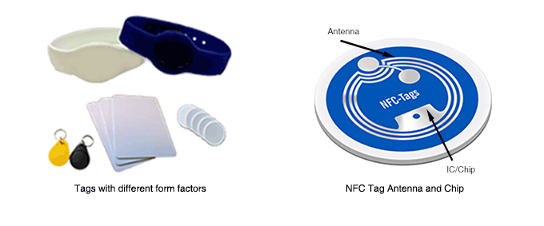
NFC Tags – Target

Slide 6
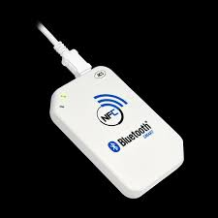
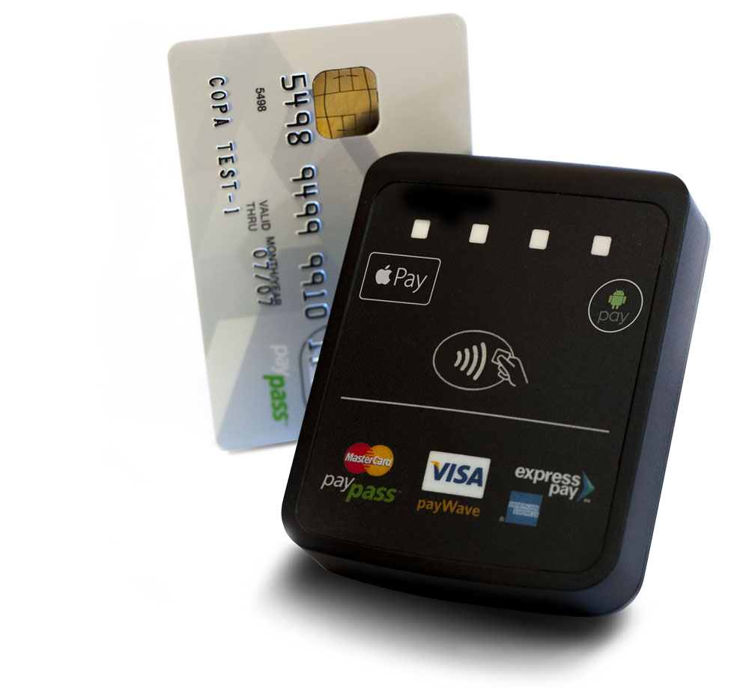
NFC Readers- Initiator

Slide 7
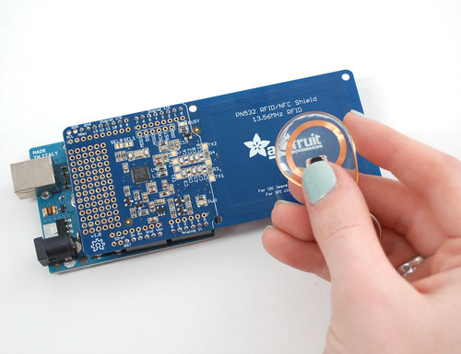
Adafruit PN532 NFC Shield

Slide 8
NFC Operation Mode
Peer-to-Peer Mode
Using NFC for exchanging information between two devices.
Card Emulated Mode
The smartcard chip embedded in the mobile phone to achieve the card emulation
The emulated card stores the confidential information of user.
Reader/Writer Mode
The NFC device would read the content of the NFC tags.
Tags store the information to NFC Data Exchange Format (NDEF).

Slide 9
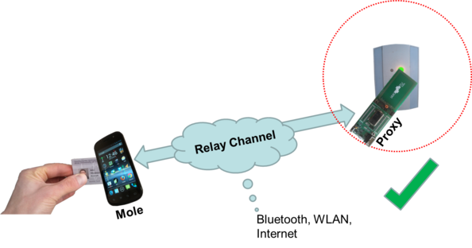
NFC Relay Attack.

Slide 10
Relay Components
Mole or Master Device.
Reads the Card details by scanning the users pocket or purse for NFC credit cards.
Sends the scan results it to Proxy device over the relay channel.
Proxy or Slave Device
Card Emulated mode
Disguises as the owner of the Card at POS(Point of Sale)
Relay Channel
Wireless Medium like WLAN, Bluetooth, Internet.
Wired Medium is faster but impractical in real life scenarios

Slide 11
Demo of Relay Attack

Slide 12
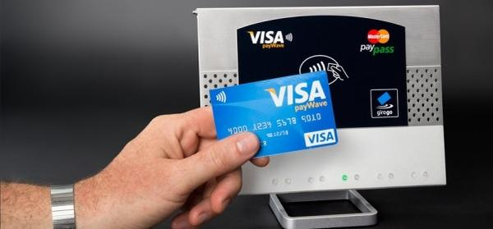
Working of NFC Credit Cards

Slide 13
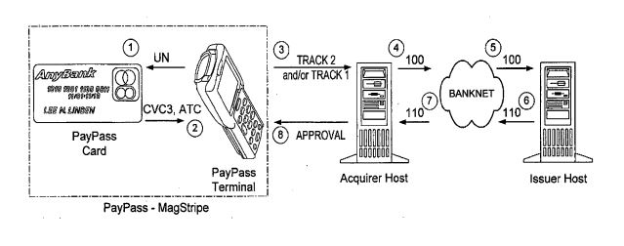
How do NFC Credit cards work?

Slide 14
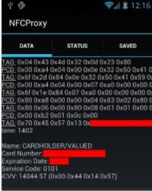
If someone Scans your card ,can they use it ?
The Use of Dynamic CVV acts as a One Time Password for every transaction.
This protects user from multiple fraudulent transactions.

Slide 15
Solution
Based on the fact that Relay attack will mostly take more time than legitimate transactions.
Added Time is :
Time to relay the information
Time to store information at Mole and Proxy.
Adding a pin authentication every time it takes more time than the threshold marked to indicate legitimate transactions.

Slide 16
Our Experiment Set Up
We used raspberry pi and Adafruit NFC PN532 shield along with LIBNFC to scan a Mifare Classic 1K card.
Measured the time it takes to scan the card multiple times to mark the threshold.
THEN we measured the time it takes to relay the scanned card to another Laptop connected over WiFi via ssh.

Slide 17
Results
Time difference was almost 500 ms
It is huge here because of the hardware we use is not as good as the readers used for POS and hacking.
We found that the time to send the relay information was still approx. 18 ms which still makes a huge difference when it comes to Timing the transaction

Slide 18
Two-Factor Authentication
We implemented a simulation of how and when a pin should be asked if it exceeds the threshold time to make the transaction.
Implemented in Arduino IDE and Adafruit NFC librabry
A slight delay of 18ms was added to the read code that represents relay attack. (due to lack of hardware)

Slide 19
Conclusion
The level of security depends on high tight the time constraints are.
Using a Pin authentication system every time the time is exceeded will block the attacker from using the card.
In case of delay caused due to interference or other anomalies, the user can enter his Pin to proceed with transaction.
This security can be broken if attacker develops and uses advanced hardware that relays within the threshold time.
This security feature protects users from current practical relay attacks where the readers are usually Phones with NFC capabilities.

Slide 20
Thank you
Questions?

